Slide 1
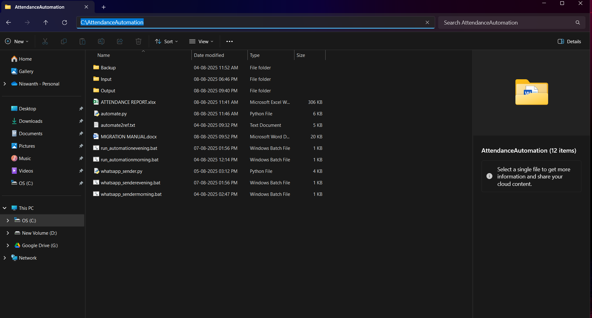
INSTALLATION AND MIGRATION PROCEDURES
STEP 1: Move the AttendanceAutomation Folder to the respective device and ensure to store it in exact same path.

Slide 2
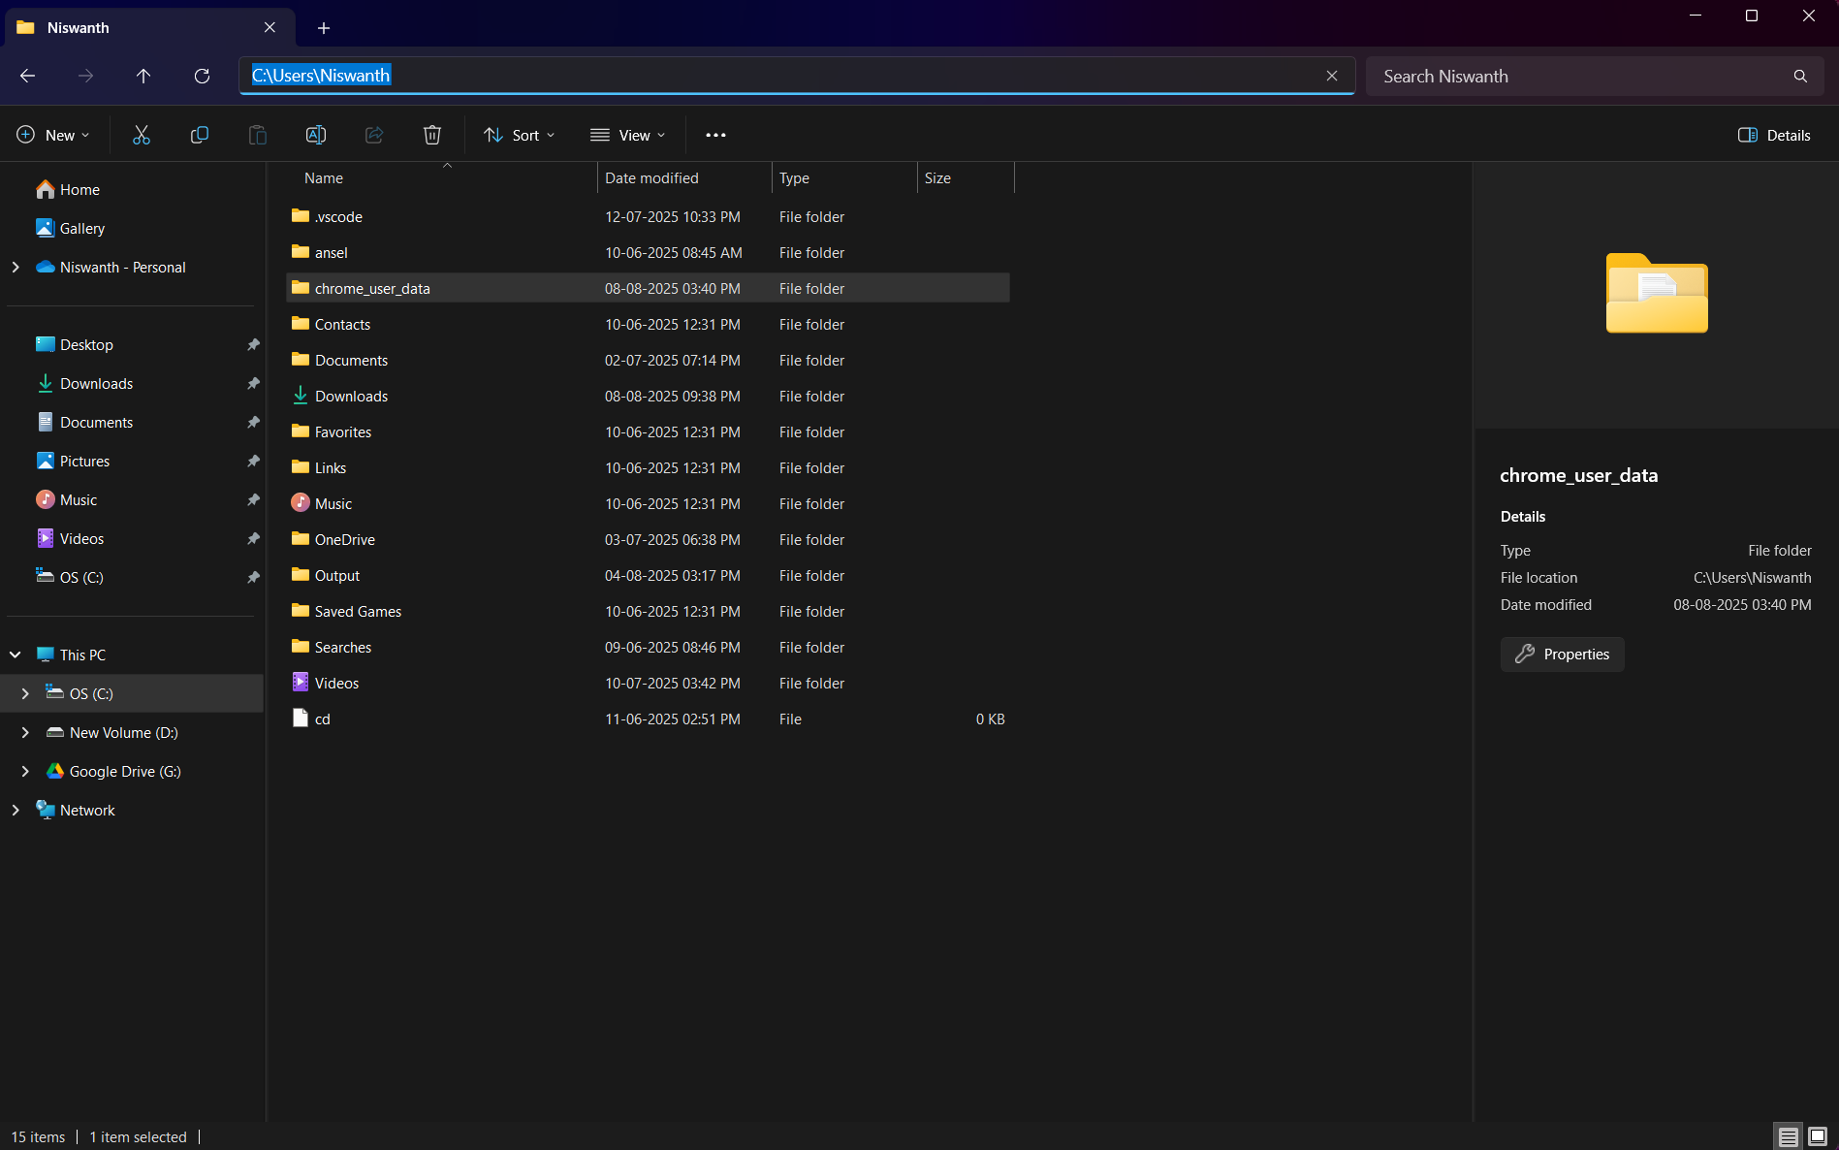
STEP 2: Create an folder of your own naming interests eg. chromedata instead of chrome_user_data and make sure to create this folder in the respective path.

Slide 3
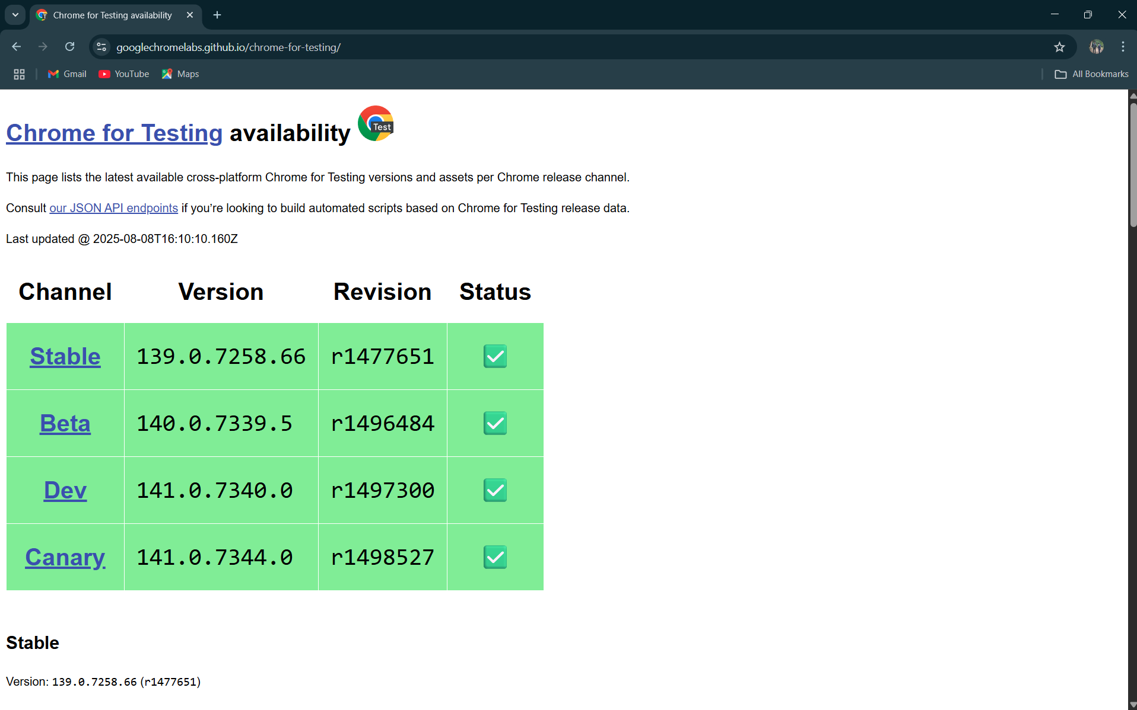
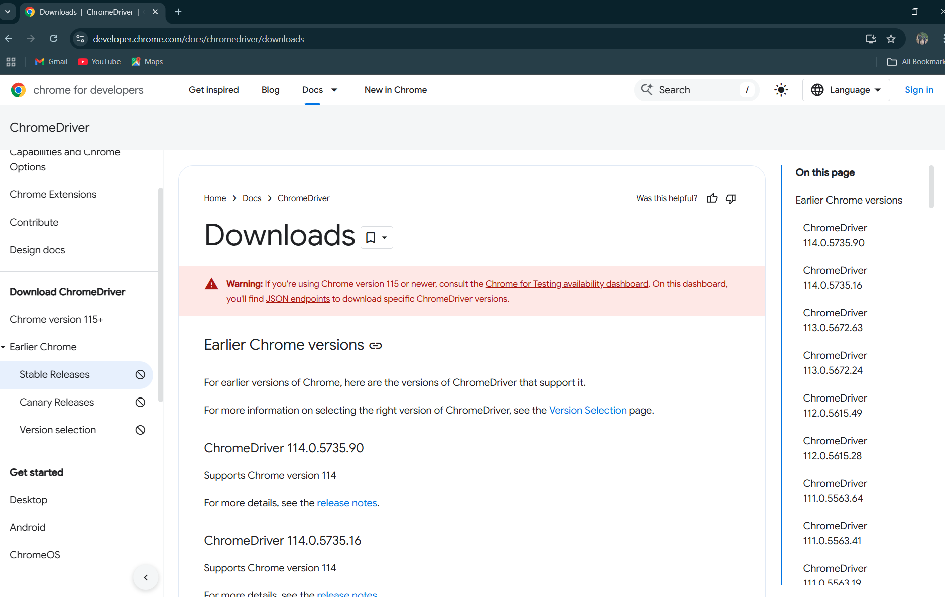
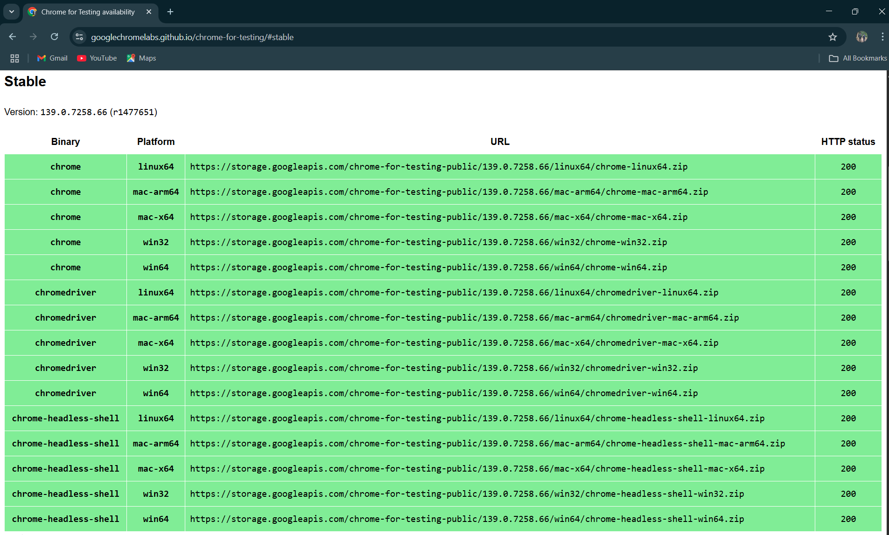
STEP 3: INSTALL Chromedriver from
https://developer.chrome.com/docs/chromedriver/downloads
Click on chrome version 115+
Then click on Stable
Choose the binary and platform according to your system configuration eg.based on bits(64bits or 32 bits).Copy the link and paste it in new tab and chromdriver will begin installing immediately.
NOTE: ONCE THE CHROMEDRIVER IS INSTALLED EXTRACT THE ENTIRE FOLDER AND NEXT STEP NAVIGATE INSIDE THE EXTRACTED FOLDER AND YOU WILL FIND AND extenstion as chromedriver.exe copy that and store it in its appropriate path REFER WITH SLIDE 4 FOR THE PATH
2.
1.
3.

Slide 4
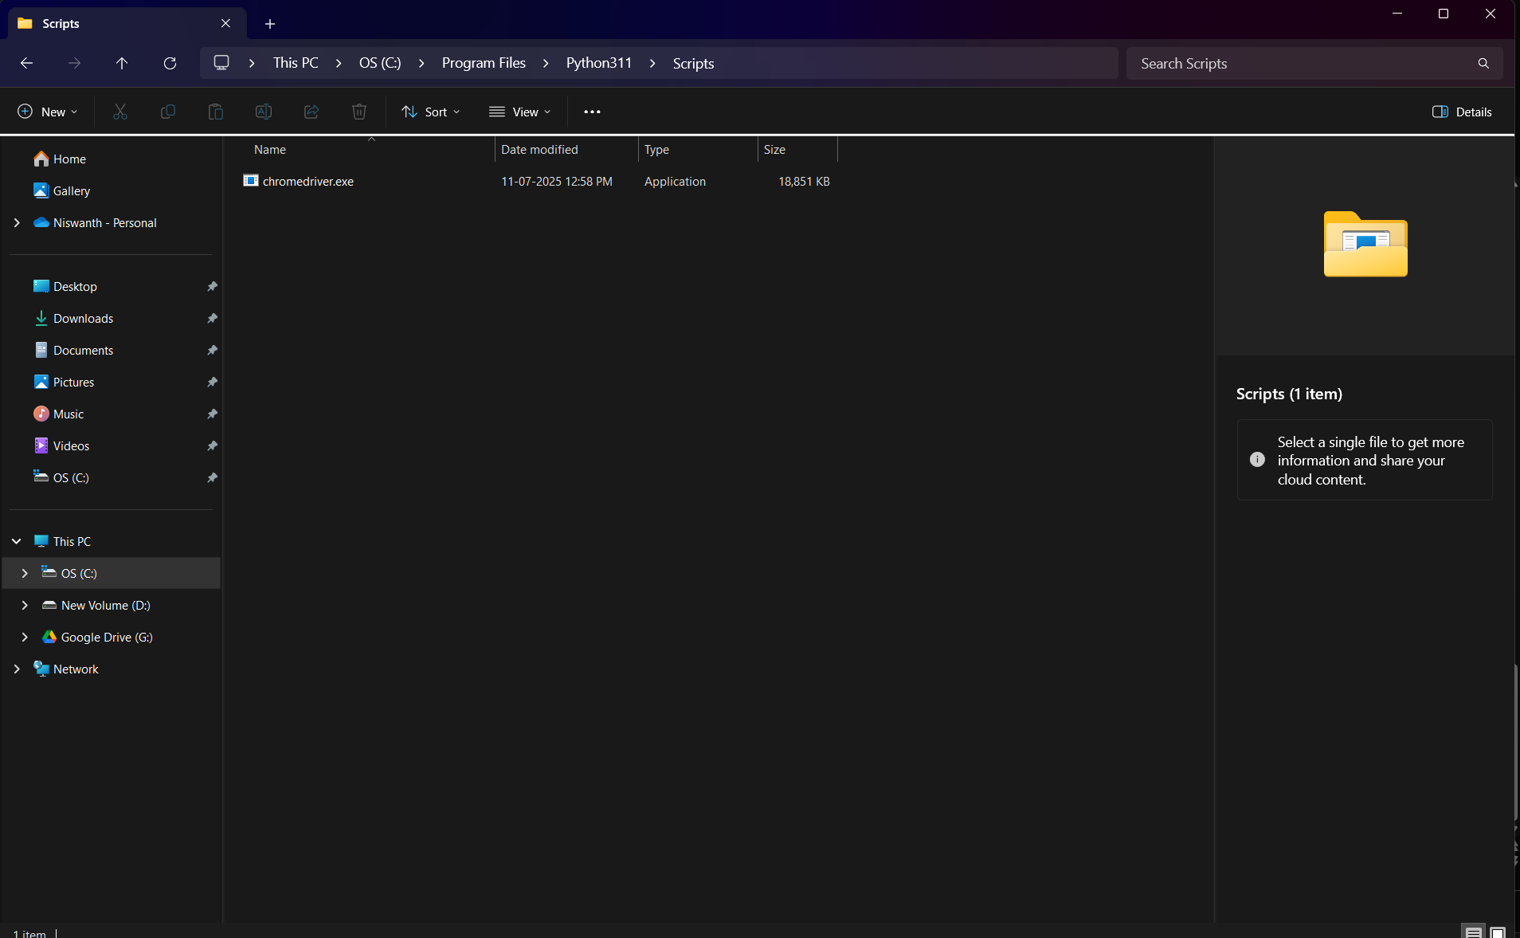
STEP4: CHROMEDRIVER PATH Be sure to store the chromedriver.exe in this path

Slide 5
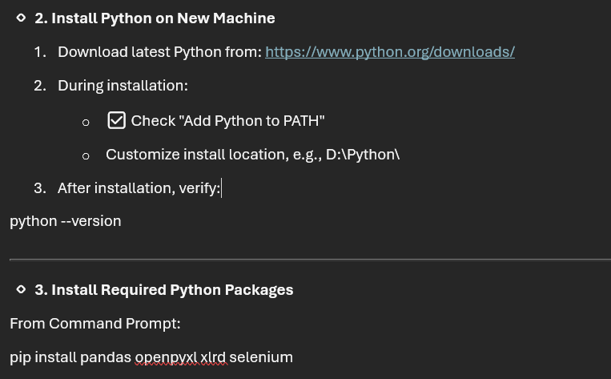
STEP 5: Download python
python –version
pip install pandas openpyxl xlrd selenium
pip install selenium pyperclip
pip install pandas watchdog selenium openpyxl
pip install pandas openpyxl selenium watchdog
pip install selenium python-dateutil pyperclip pip install selenium python-dateutil psutil pyperclip
NOTE:USE THE BELOW 2 LINE CODE AND REPLACE IT IN THE WHATSAPP BOT CODE AT THE LAST LINE if __name__ == "__main__":
run_bot()
After installation make sure to store python.exe in the disk D

Slide 6
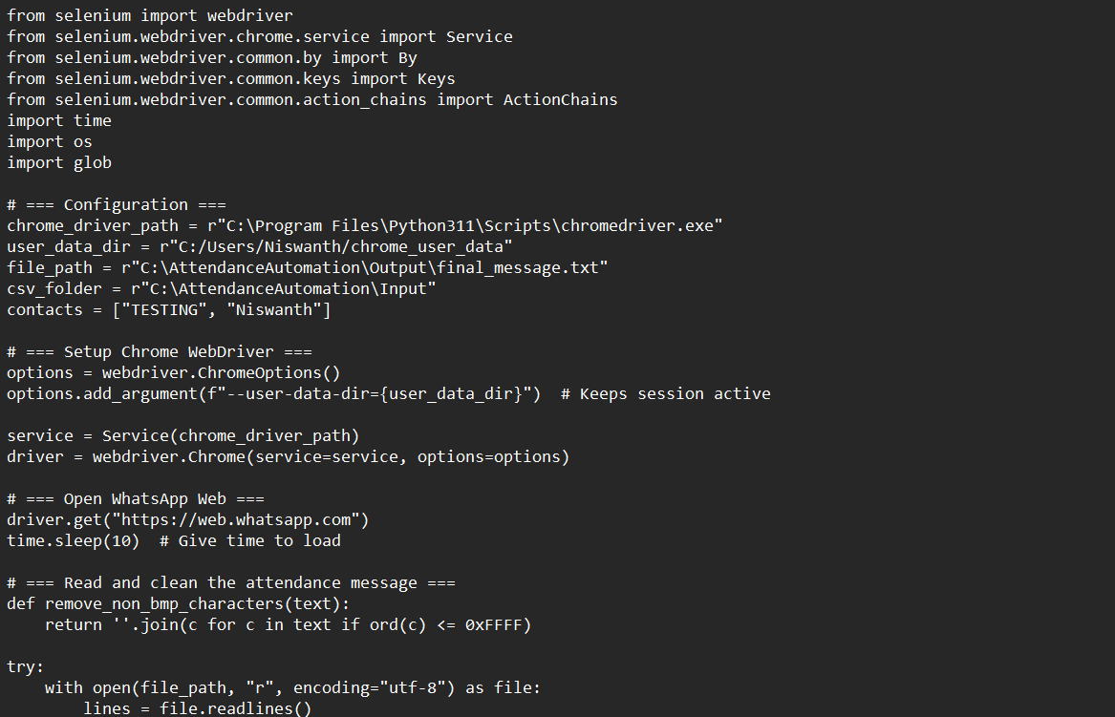
STEP 6: PATH CHECKING CHECK THE PATH AND SET THE SAME ACCORDING TO THE IMAGE

Slide 7
STEP 7: SETTING UP WATCH DOG
Batch File for Auto Start
start_watcher.bat
Press windows key +R shell:startup IT WILL OPEN AN FOLDER now PLACE THE start_watcher.bat

Slide 8
NOTE: IF NOT ABLE TO INSTALL PLEASE DO CHECK THE INSTALLATION VIDEO IN THE AttendanceAutomation Folder for further integration
BOT IMPLEMENTATIONS : C:\AttendanceAutomation\
│
├── whatsapp_bot.py
├── supervisor.py
├── watcher.py
├── start_bot.bat
├── run_supervisor.bat
├── pause_bot.py
├── resume_bot.py
├── watcher_startup.bat
├── start_bot_startup.bat
├── Backup\ # (contains attendance backup .txt files)
└── Logs\ # (optional for cleaner logging)
PACKAGES TO INSTALL
pip install selenium pyperclip psutil python-dateutil
pip install pyzk
pip install openpyxl
pip install pillow
NOTE:REMEMBER THAT WE HAVE TO SETUP TASK SCHEDULER FOR SUPERVISOR

Slide 9
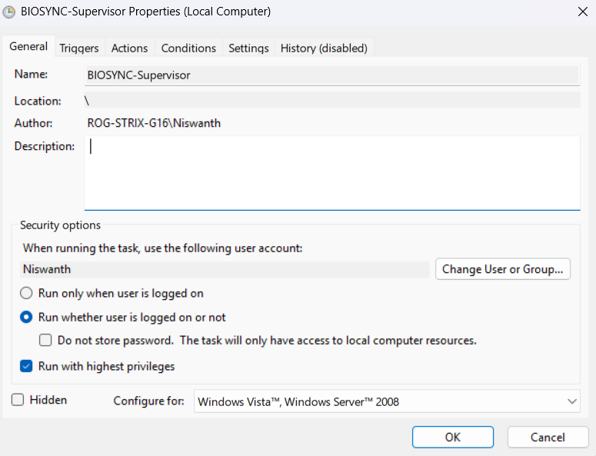
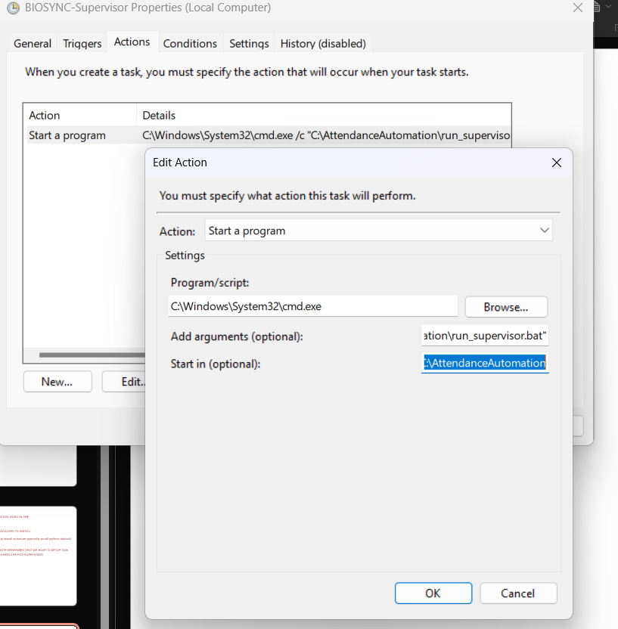
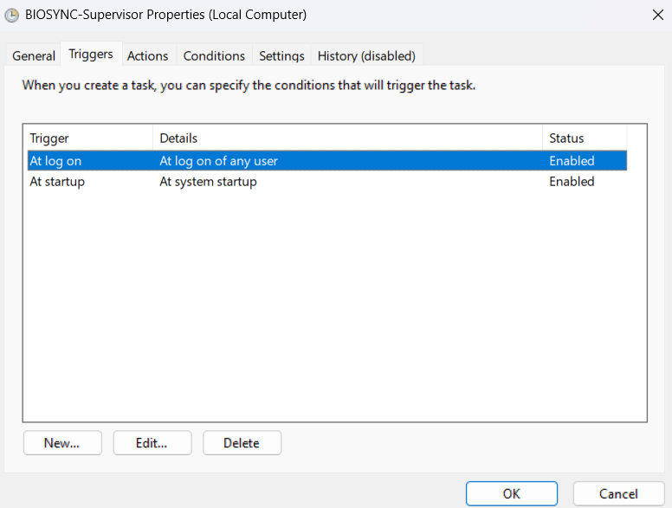
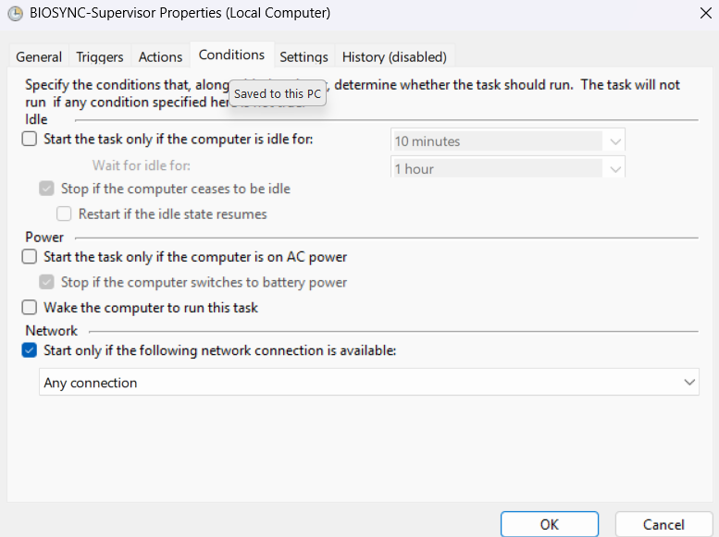
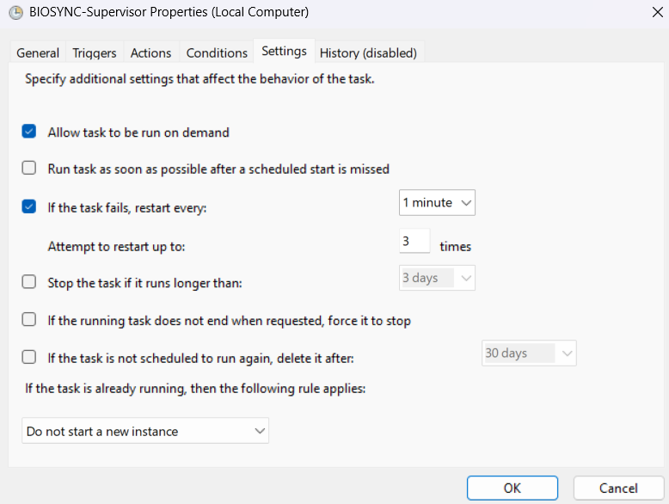
C:\Windows\System32\cmd.exe /c "C:\AttendanceAutomation\run_supervisor.bat“
C:\AttendanceAutomation

